Slide 1
Causal Reasoning
Hanna Co

Slide 2
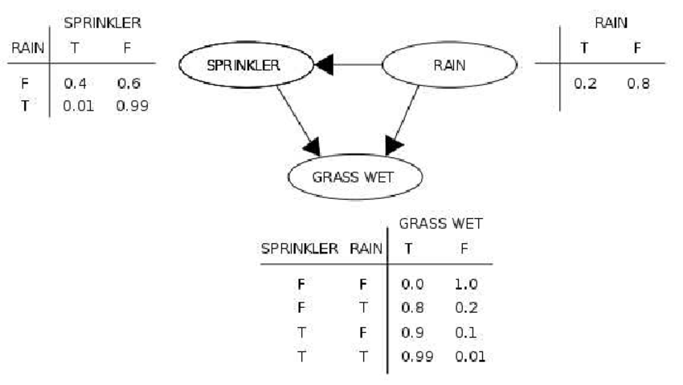
Background
Pearl is credited with the invention of Bayesian networks, as well as a framework for causal inference
revolutionized the field of artificial intelligence, as well as other fields
correlation ≠ causation
Notes:
able to reason about events and describe the relationship between events

Slide 3
Current State-of-the-Art
Current State
Ladder of Causation
Reasoning Software: samiam
Expansion: counterfactual reasoning, unit selection
Notes:
ladder: association (observation), intervention (doing), counterfactual (what if)
UCLA's Automated reasoning group built samiam – software for modeling, reasoning, sensitivity analysis
expansion beyond basic causality into counterfactual reasoning and unit selection

Slide 4
Schedule
Week 3
Week 4
Week 5
Literature Review: Pearl's Work
Literature Review: Related Works
Literature Review: Applications
Week 6
Week 7
Week 8+
Long Presentation Preparation
Long Presentation + Final Paper
Final Paper

Slide 5
References
ACM. (2011). Judea Pearl. Judea Pearl - A.M. Turing Award Laureate. https://amturing.acm.org/award_winners/pearl_2658896.cfm
Pearl J. Probabilistic reasoning in intelligent systems: networks of plausible inference. Burlington: Morgan kaufmann; 1988.
Pearl, J. Causality (Cambridge Univ. Press, 2009).

